Slide 1

Awesomeness
Alice Daish
@alice_data
Data Scientist

Slide 2

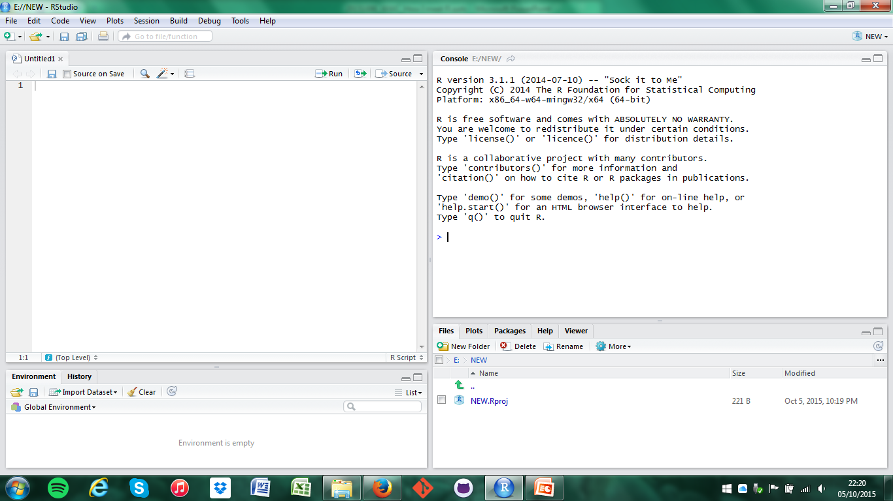
@alice_data #rstats www.r-project.org/
Notes:
R with R studio which is a nicer interface and have many capabilities.
Its not only the 18th letter in the alphabet
But it’s a open source programming language and software environment
for statistical computing and graphics that is one the raise.
Developed by statisticians from New Zealand and
historically used by academics,
But big business and enterprises are embracing R including Data Scientists community .

Slide 3
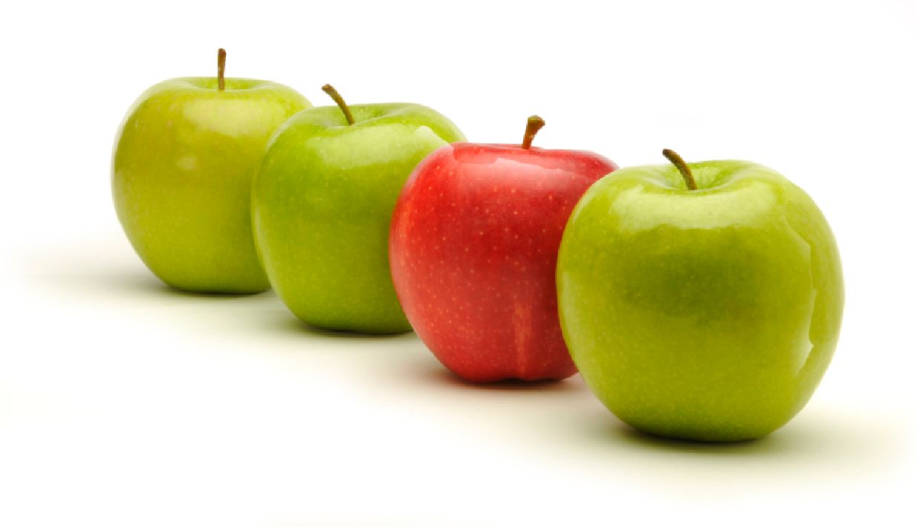
@alice_data #rstats www.r-project.org/
Notes:
What makes R different/ special?
Picture
Packages
People
Stats
R focuses on user friendly data analysis, statistics and graphical models
Huge support group
Packages (functions, data and compiled code can be added with one line)
(http://www.kdnuggets.com/2015/05/r-vs-python-data-science.html)
How is it different from Python?
Better Visualisation, can’t offer the alternative for 100’s of essential packages that R has.
R has a steeper learning curve but its worth it

Slide 4
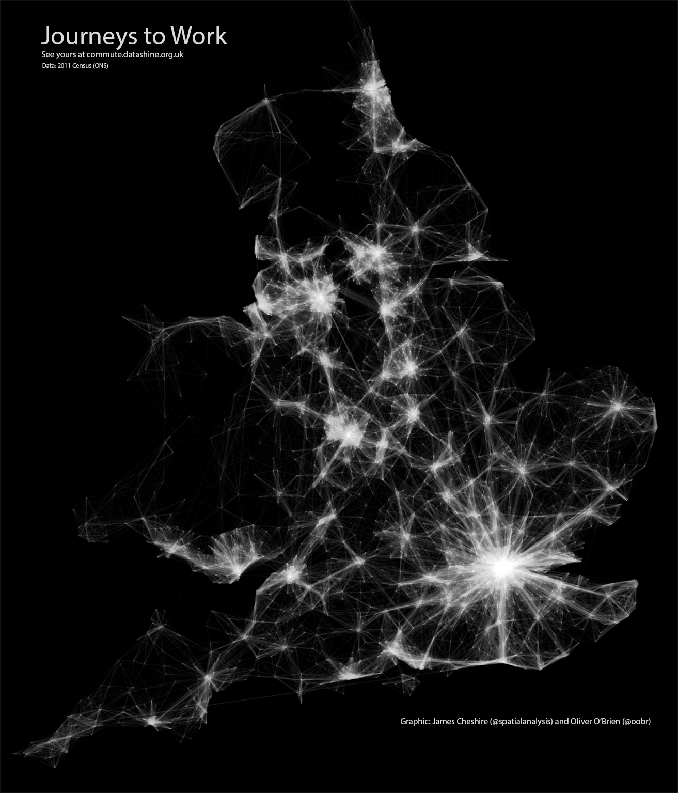
http://spatial.ly/
@alice_data #rstats www.r-project.org/
Notes:
What makes R different/ special? PICTURES
Picture says a 1000 words – R can create some amazing visualisations
Be inspired by James Cheshire - Spatial mapping of journeys to work using ggplot2 check out spatial.ly

Slide 5
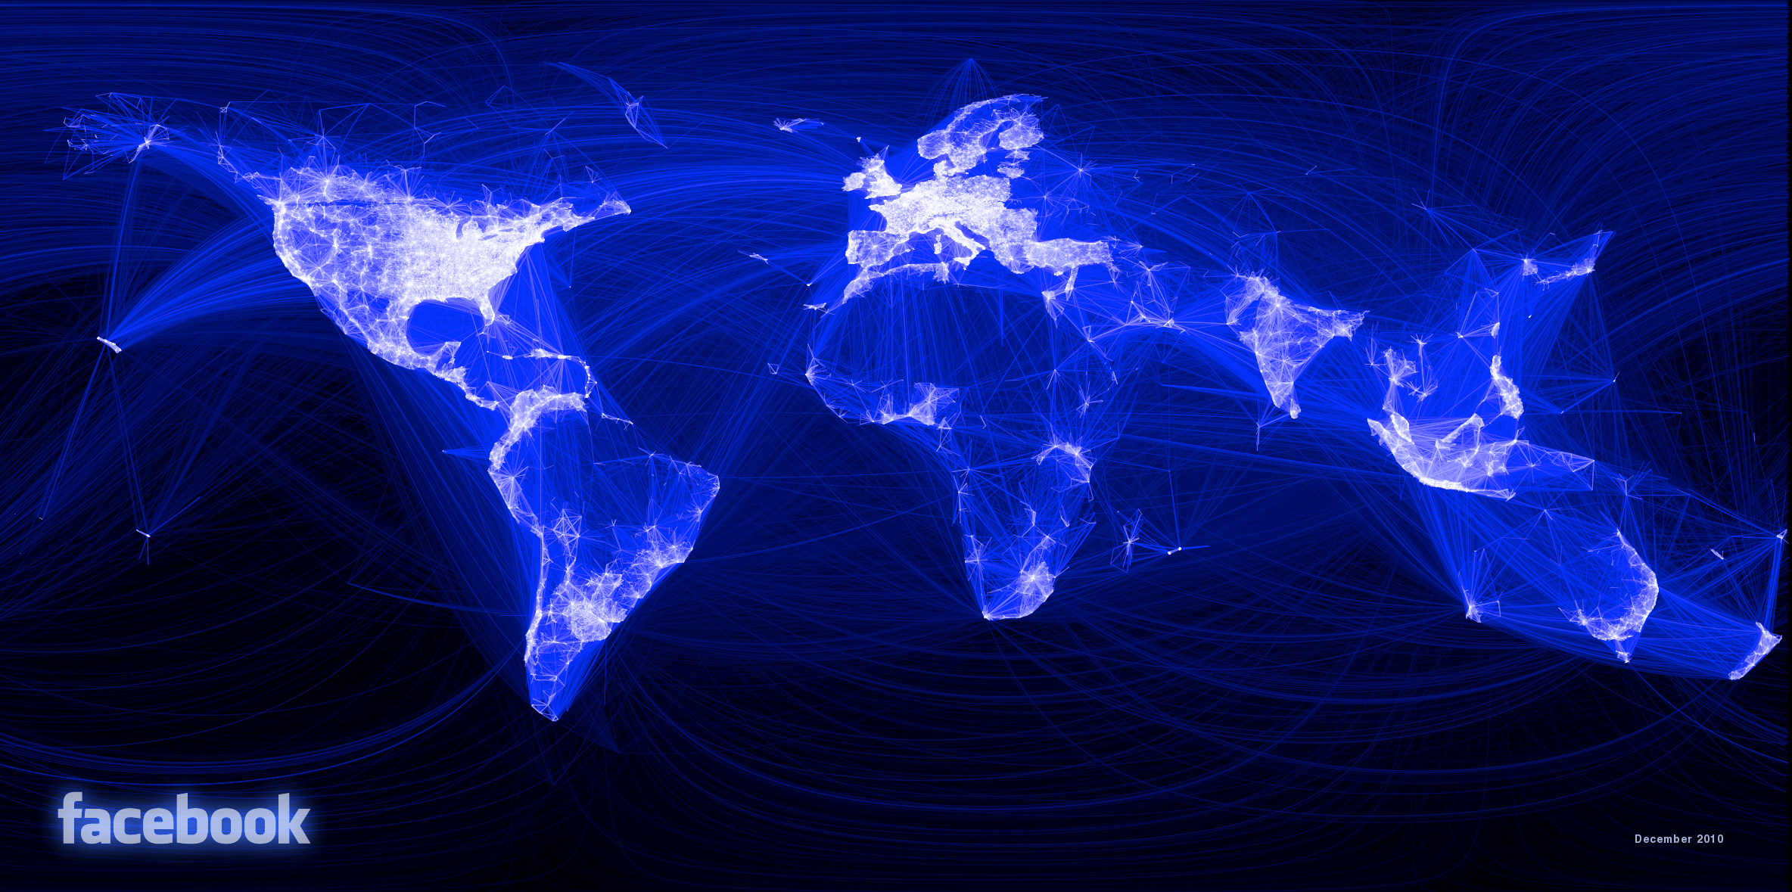
https://www.facebook.com/note.php?note_id=469716398919
@alice_data #rstats www.r-project.org/
Notes:
What makes R different/ special? PICTURES
Be inspired by James Cheshire - Spatial mapping of journeys to work check out spatial.ly

Slide 6
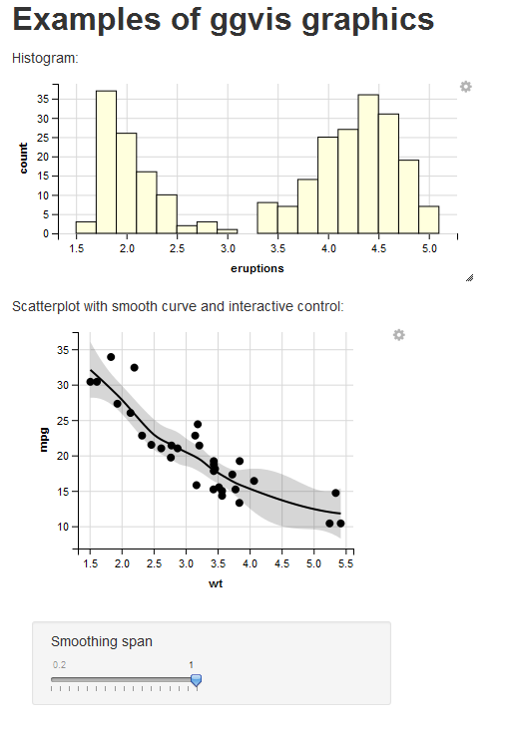
http://ggvis.rstudio.com/
@alice_data #rstats www.r-project.org/
Notes:
What makes R different/ special? PICTURES
Interactive
ggvis

Slide 7
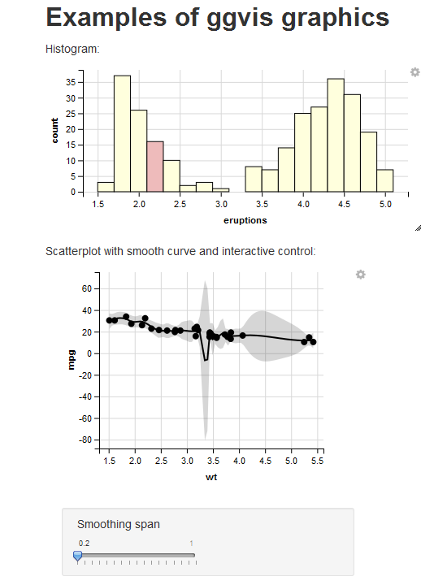
http://ggvis.rstudio.com/
@alice_data #rstats www.r-project.org/
Notes:
What makes R different/ special? PICTURES
Interactive
ggvis

Slide 8
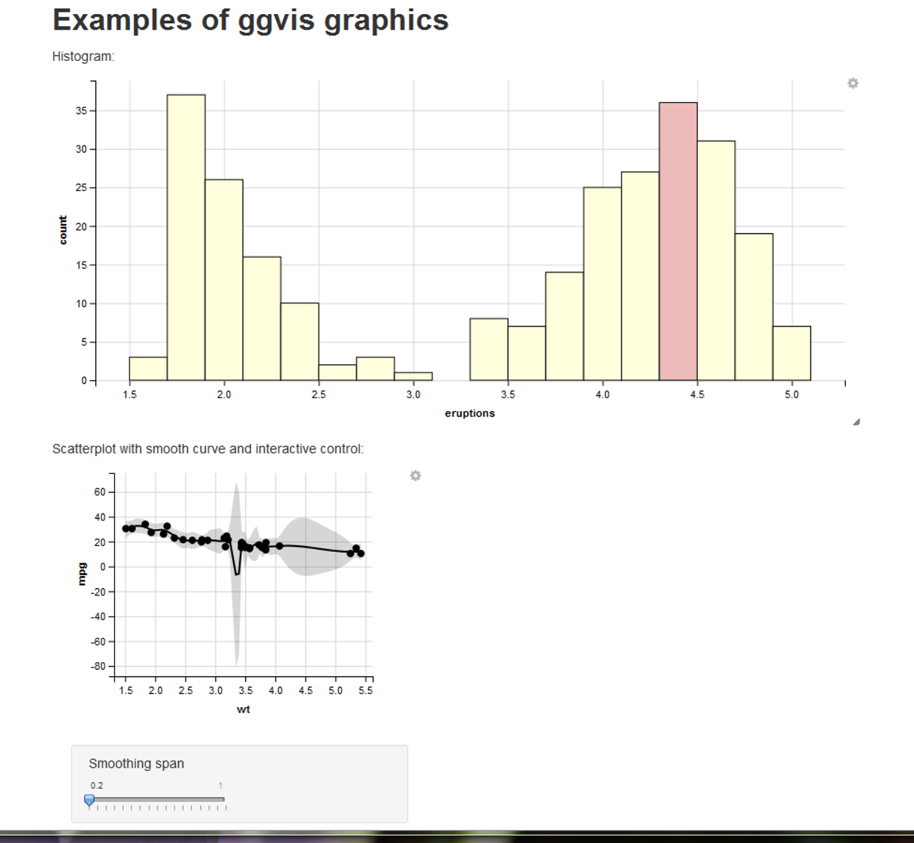
http://ggvis.rstudio.com/
@alice_data #rstats www.r-project.org/
Notes:
What makes R different/ special? PICTURES
Interactive
ggvis

Slide 9
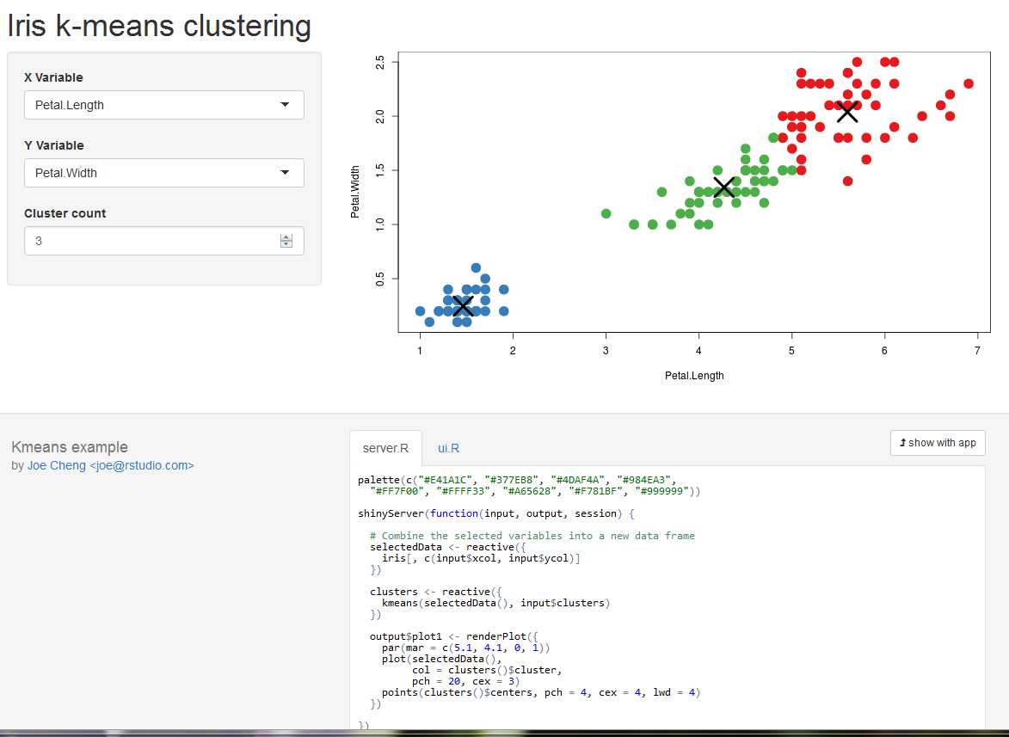
http://shiny.rstudio.com/gallery/
@alice_data #rstats www.r-project.org/
Notes:
What makes R different/ special? PICTURES
Application
Shiny

Slide 10
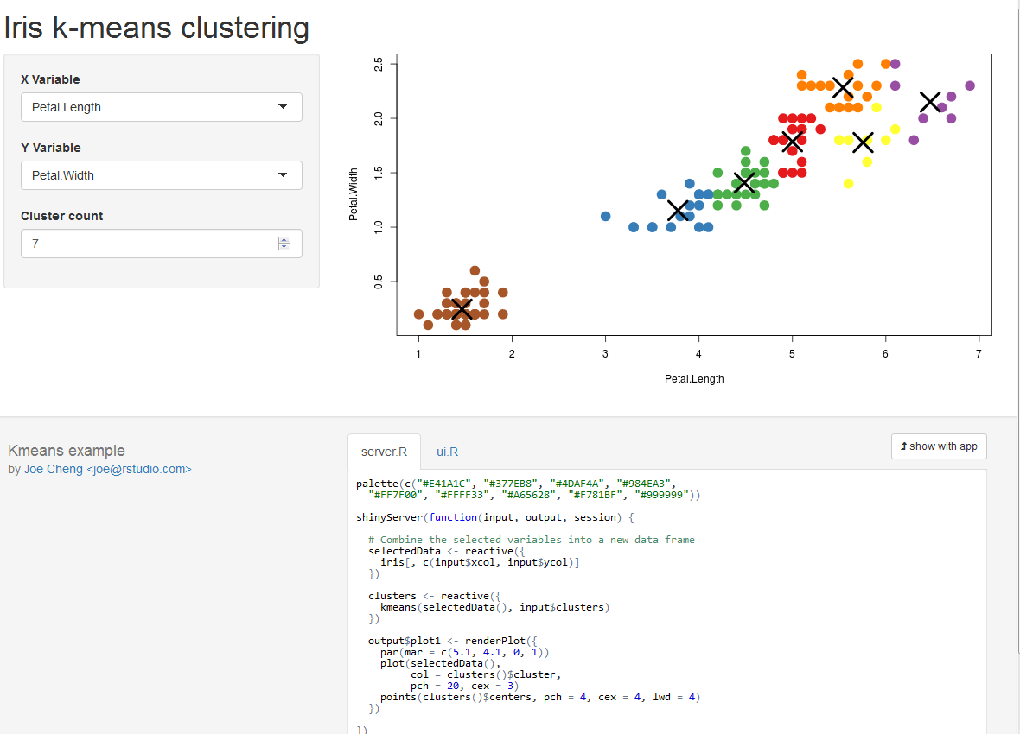
http://shiny.rstudio.com/gallery/
@alice_data #rstats www.r-project.org/
Notes:
What makes R different/ special? PICTURES
Application
Shiny

Slide 11

@alice_data #rstats www.r-project.org/
Notes:
What makes R different/ special? PACKAGES
If you have a problem I bet someone has created a solution for you
Dplyr – data manipulations to help you filter, select, arrange, slice, summarise
Data.table – if you a SQL person data table always you to select, by and from like sql
Knitr – dynamic reporting you can knit your code, graphics, analysis and reporting altogether using Rmarkdown to produce html, pdf, word and presentation report within your console no need to copy and paste into word reports ever again.
D3 Bubbles in R

Slide 12
7284
@alice_data #rstats www.r-project.org/
Notes:
What makes R different/ special? PACKAGES
If you have a problem I bet someone has created a solution for you
Dplyr – data manipulations to help you filter, select, arrange, slice, summarise
Data.table – if you a SQL person data table always you to select, by and from like sql
Knitr – dynamic reporting you can knit your code, graphics, analysis and reporting altogether using Rmarkdown to produce html, pdf, word and presentation report within your console no need to copy and paste into word reports ever again.
http://www.kdnuggets.com/2015/06/top-20-r-packages.html

Slide 13
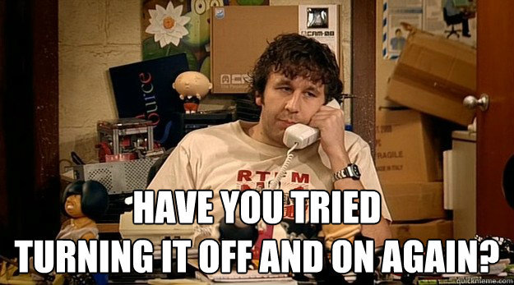
@alice_data #rstats www.r-project.org/
Notes:
What makes R different/ special? PEOPLE
You can google every error
Documentation is impeccable and if you can’t fix it someone will help you so your never along
There is a great stackoverflow community who respond super quickly

Slide 14
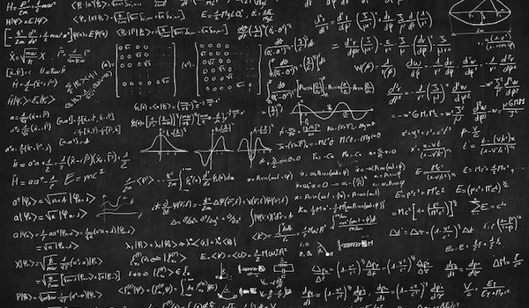
@alice_data #rstats www.r-project.org/
Notes:
What makes R different/ special? Stats
All developed on a strong statistical foundations

Slide 15
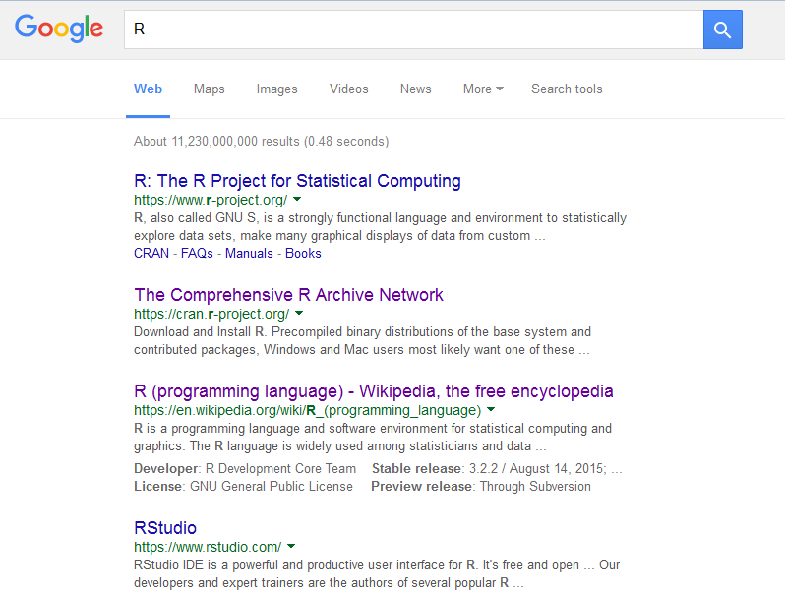
Download
Download
@alice_data #rstats www.r-project.org/
Notes:
Try it – its free and awesome

Slide 16







Thanks
@alice_data
esources
#rstats
@rstudio
@Rbloggers
LondonR
@RLangTip
@rOpenSci
R Coding dojo
@hadleywickham

